Slide 1

Hotel Booking Analysis
Presented by Sayali Madhukar Babar

Slide 2

Initial Exploration Visuals

Slide 3
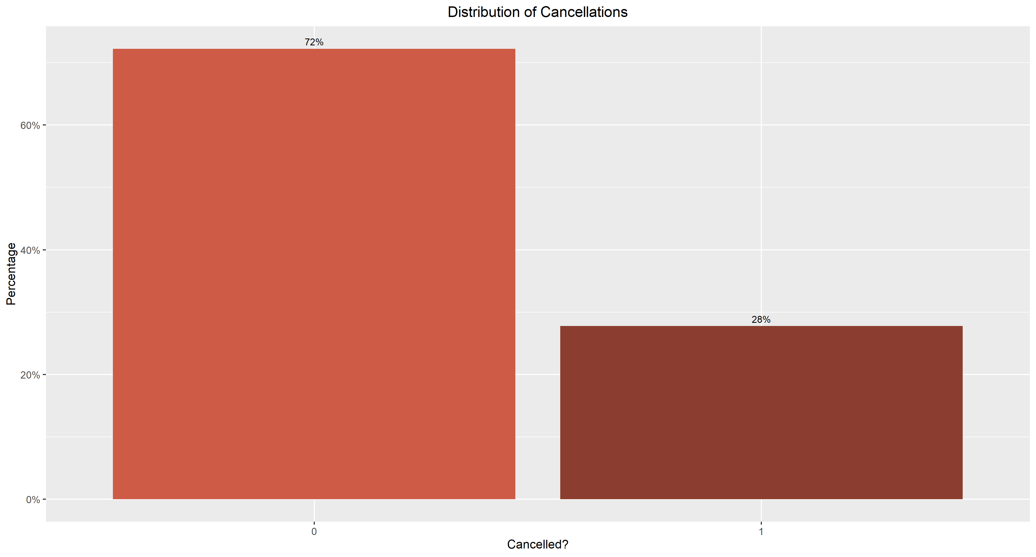
What Proportion of Reservations Get Cancelled?
28% of total reservations get cancelled

Slide 4
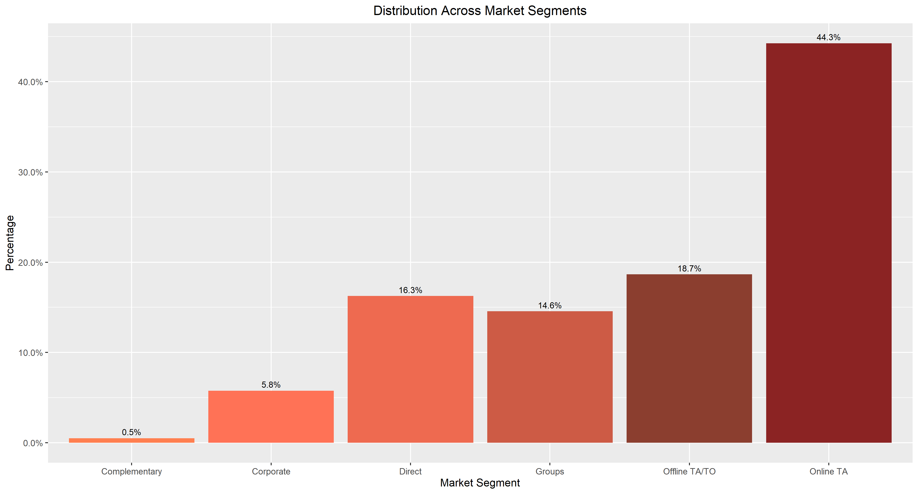
What is the Distribution of Market Segments For the Customers?
Nearly 45% of customers book through an Online Travel Agent

Slide 5
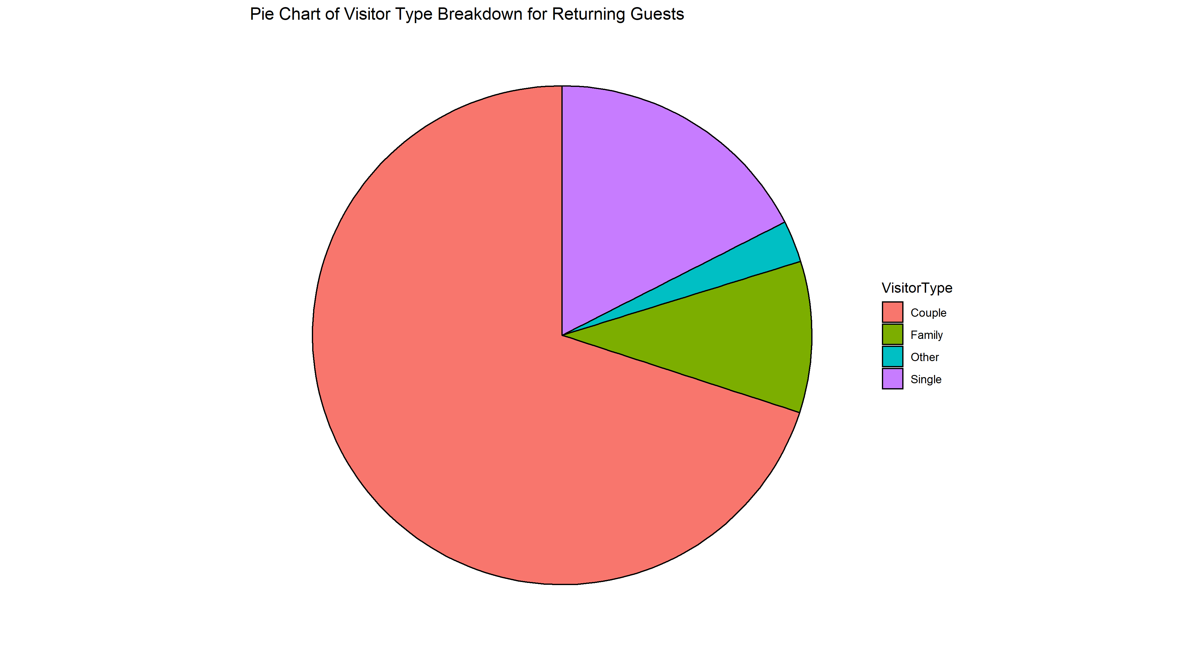
What Types of Guests Return for Another Stay?
18%
2%
10%
70%
Couples make up 70% of the guests who return

Slide 6
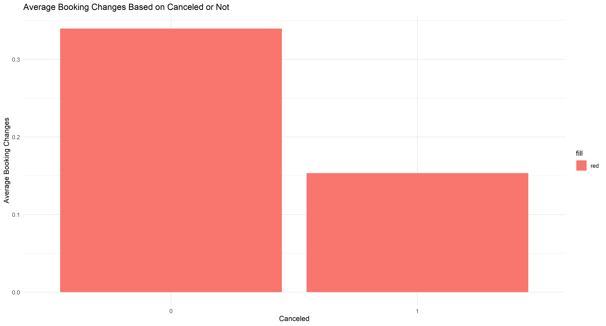
Are Cancelling Customers More Likely to Have Made Booking Changes?
Customers who don't cancel make an average of approximately 0.2 more booking changes

Slide 7
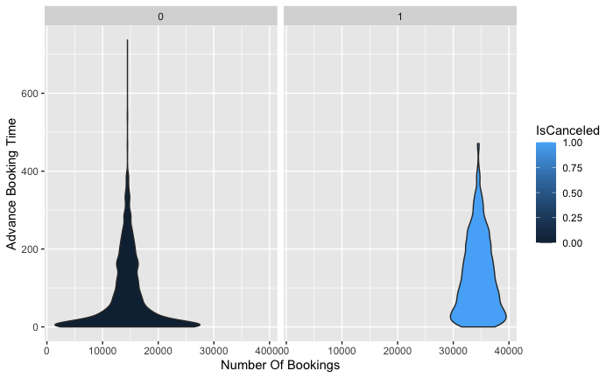
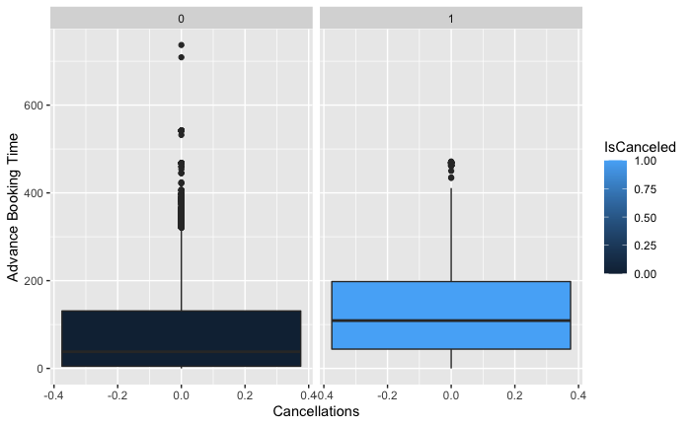
Does Lead Time Affect Number of Cancellations?
More Advance Booking Time makes cancellation more likely

Slide 8
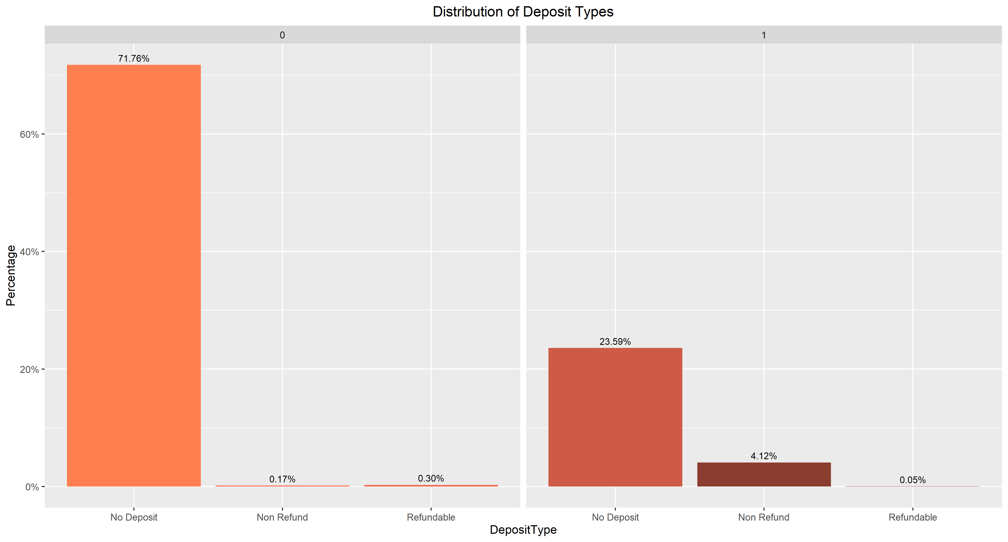
Does the Deposit Type Have an Effect on Cancellations?
96% of customers who place a non-refundable deposit cancel

Slide 9
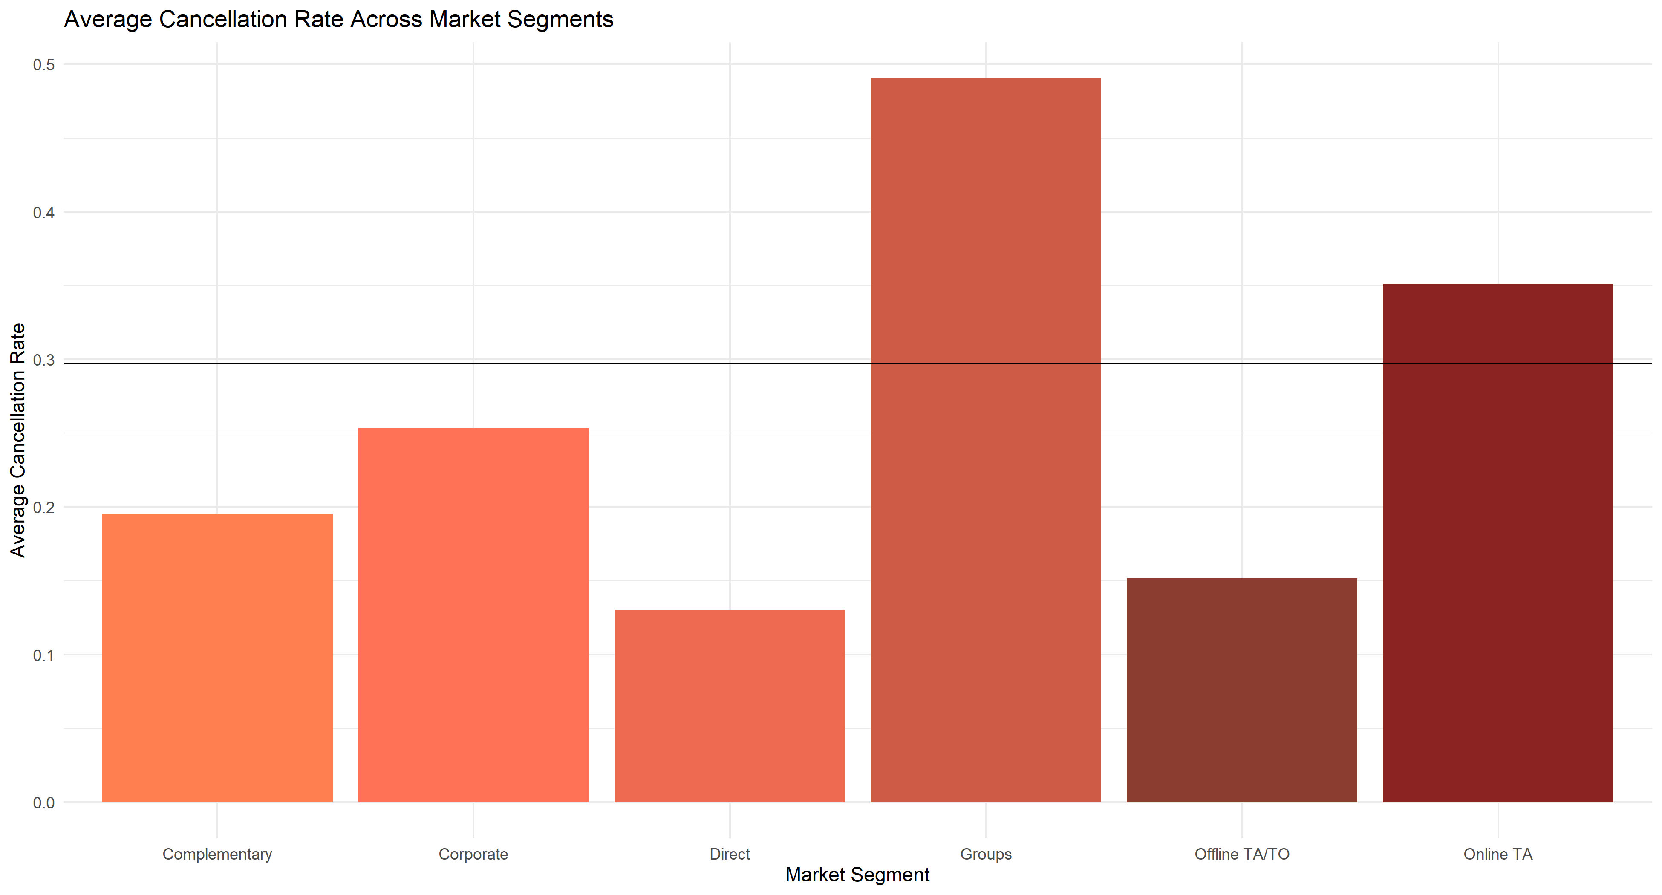
For Couples that Make Reservations, do Certain Market Segments Cancel More than Others?
The Group market segment cancels nearly 50% of their bookings

Slide 10

Suggested Solution
Provide Discounts for the two segments with above-average cancellation rates
Groups and Online Travel Agent
Work on appealing to market segments with lower cancellation rates for higher percentages of the customer base
Online Travel Agents make up over 40% of the customers' market segments and have above-average cancellation rates
Direct and Offline Travel Agents have the lower cancellation rates, so the hotel should be trying to entice people into those segments

Slide 11
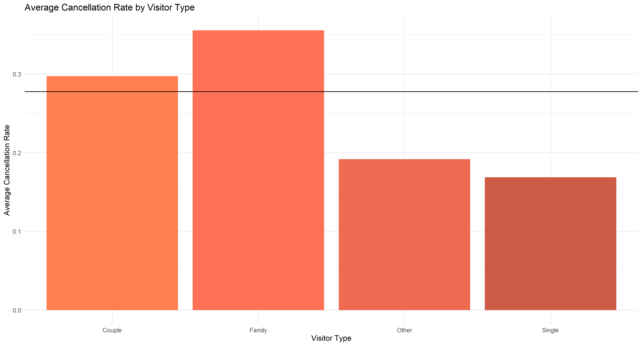
Do Certain Visitor Types Cancel More than Others?
Couples: 30% Families: 35% Other: 19% Single: 17%
Overall Average: 28%

Slide 12

Suggested Solution
Work on ways to make the hotel a better fit for families, since they have the highest cancellation rates
Advertise family discounts and family-friendly amenities
Highlight nearby attractions that will appeal to families if they exist
Train staff on how to anticipate the needs of families, especially those with younger children who could be more of a challenge
Get feedback from families who stay at the hotel for what they liked and what needs to be improved

Slide 13
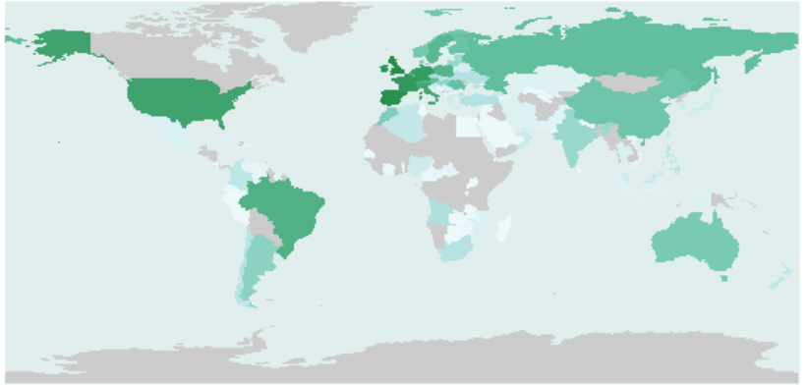
Which Countries are the Customers From?
Most of the customers are from Western Europe

Slide 14
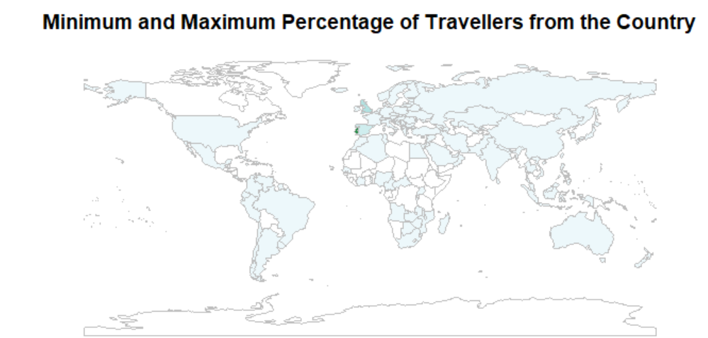
Where do the Most and Fewest Visitors Come From?
The highest number of visitors are from Portugal

Slide 15
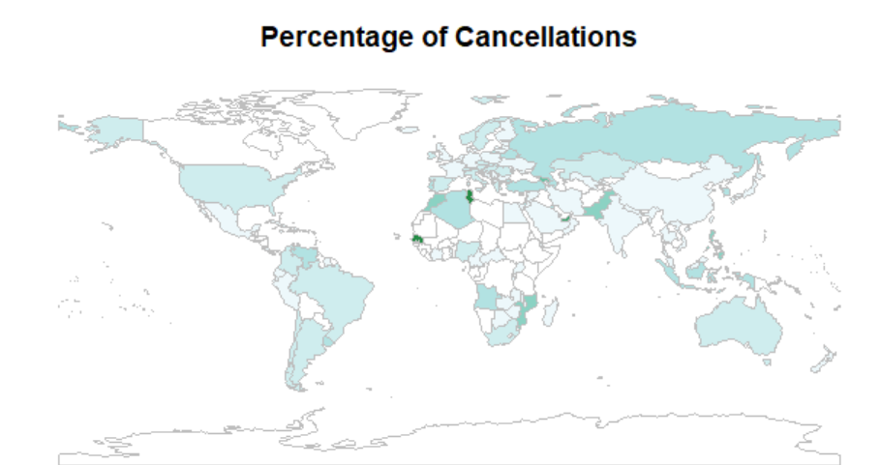
Which Country is Responsible for the Most Cancellations?
Senegal and Tunisia are responsible for the highest percentage of cancellations

Slide 16

Analysis Visuals

Slide 17
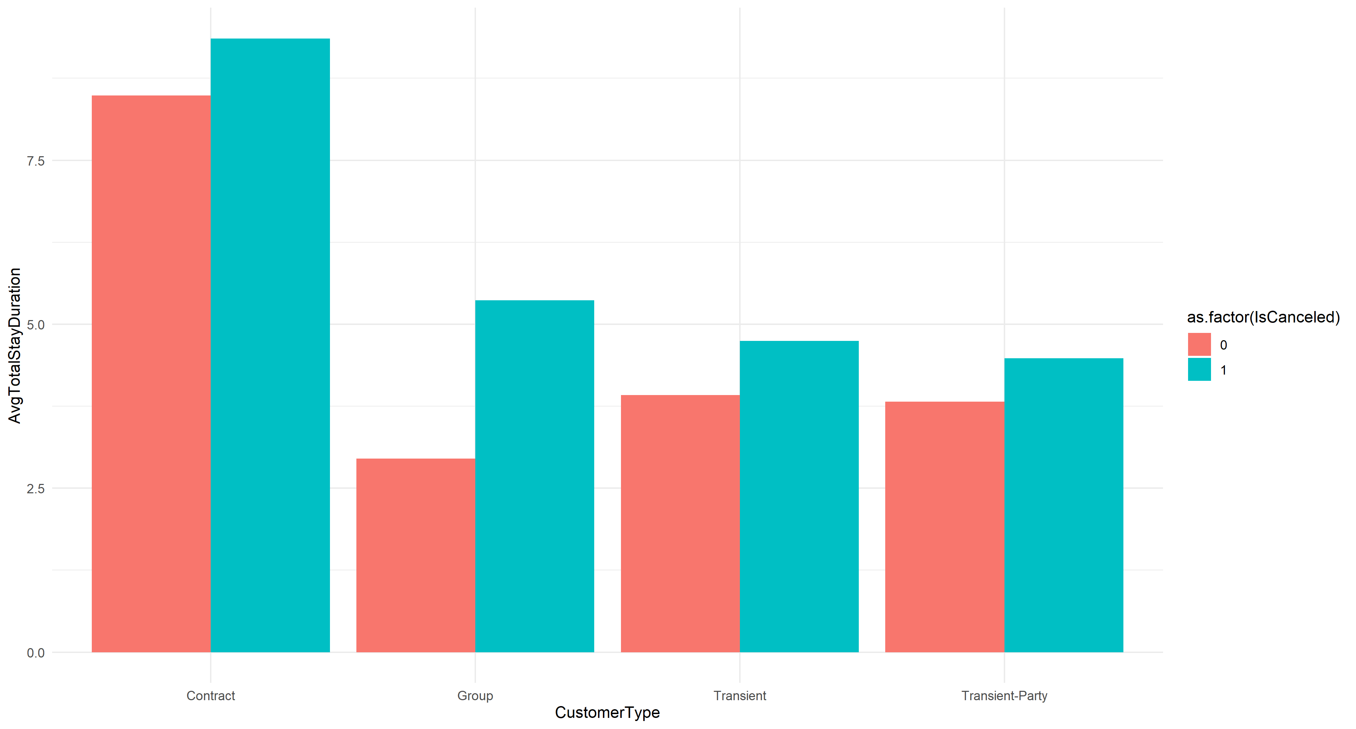
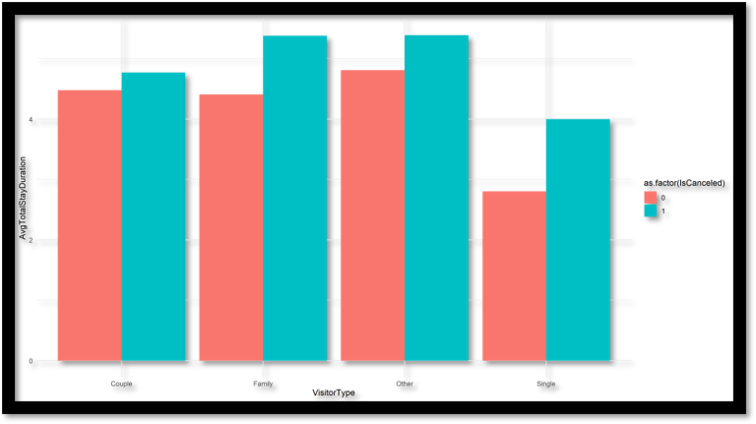
Is there a Link Between Stay Duration and Cancellation Likelihood?
Across every customer type and visitor type, cancellations correspond to higher average stay durations

Slide 18
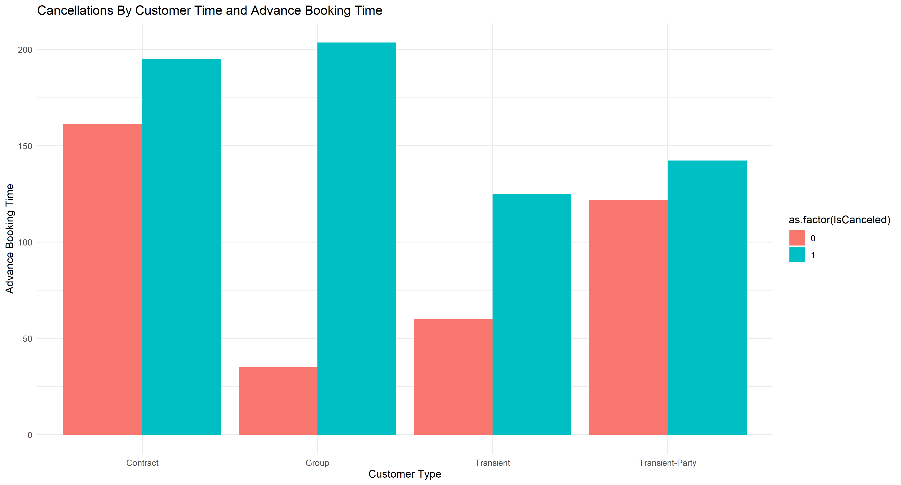
Can We Predict if a Customer Will Cancel Based on any Combination of Customer Type and Advance Booking Time?
For groups, there is a roughly 180-day difference in average advance booking time for cancelled and non-cancelled reservations, with cancelled ones being more in advance

Slide 19
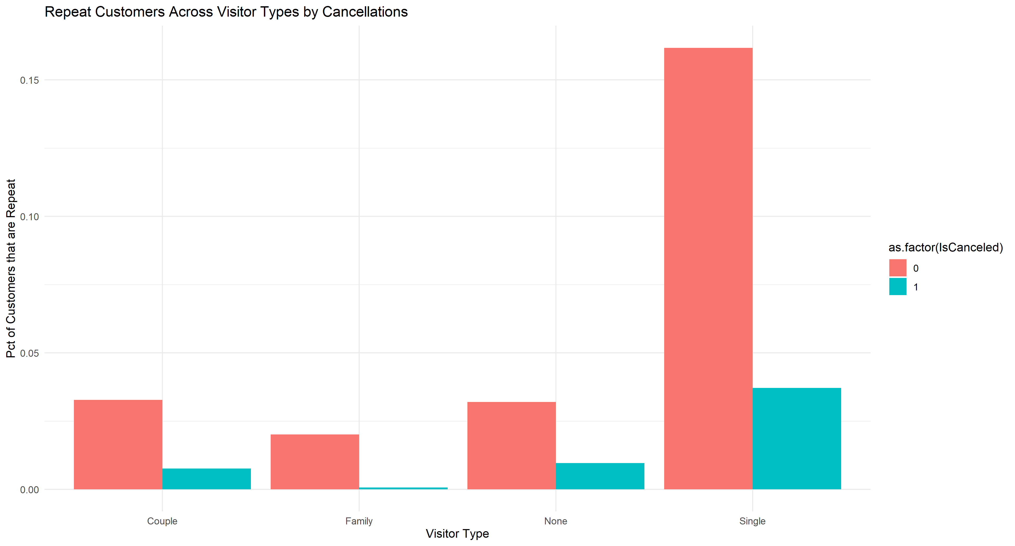
Is There a Significant Difference in Cancellations Based on Being a Repeat Customer?
17% of solo customers who don't cancel are repeat versus just 3.5% who do cancel

Slide 20

Our Proposal
Offer incentives to customers to return to the hotel for another stay, with a special focus on solo travelers
Cancellations are less likely for repeat customers no matter what, but for solo travelers, the difference is significantly larger
Returning guests are more likely to build loyalty towards the hotel and return yet again in the future
Creating and maintaining customer loyalty and returns must be a top priority

Slide 21
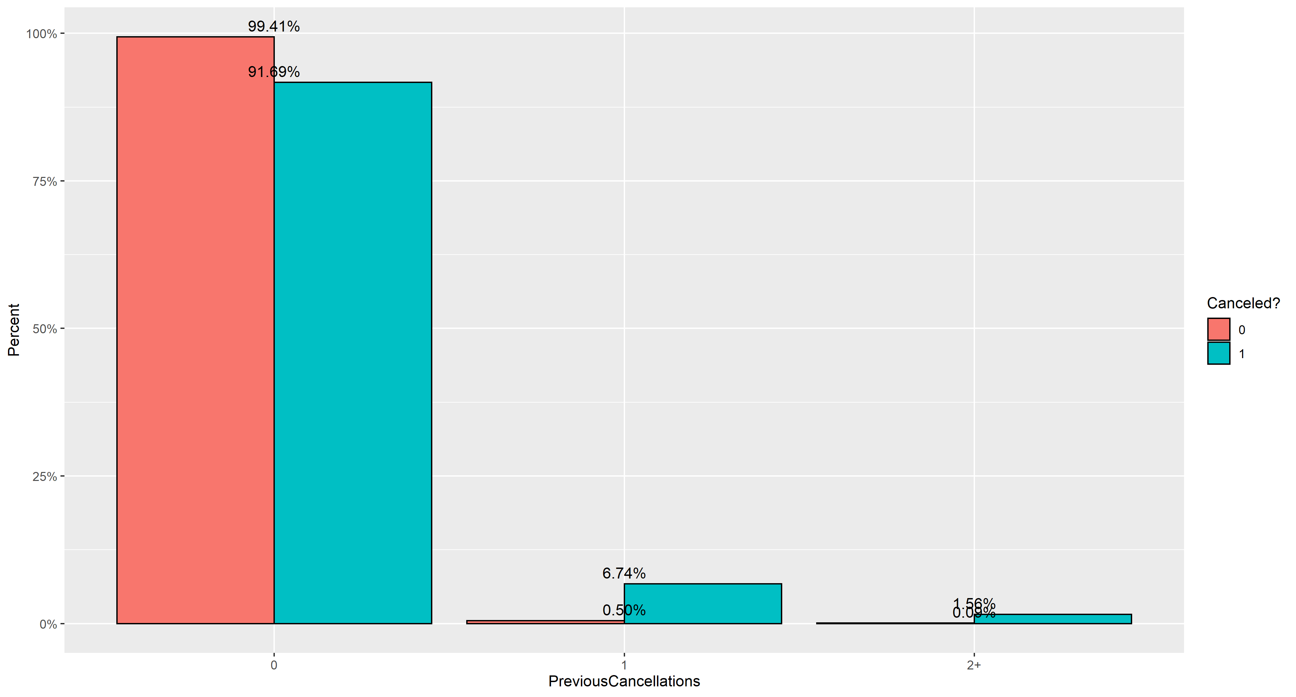
Does a Previous Cancellation Make it More Likely that the Customers Will Cancel?
Over 93% of customers who have previously cancelled a booking cancel this booking

Slide 22

Suggested Solution
Create a survey for guests who cancel their reservations
Listen to their responses and insights
Make adjustments if they have complaints or suggestions that are fixable
Goal is to make the guests feel that their feedback matters and is being listened to
Also want to improve the quality of service to their needs before their arrival if possible

Slide 23
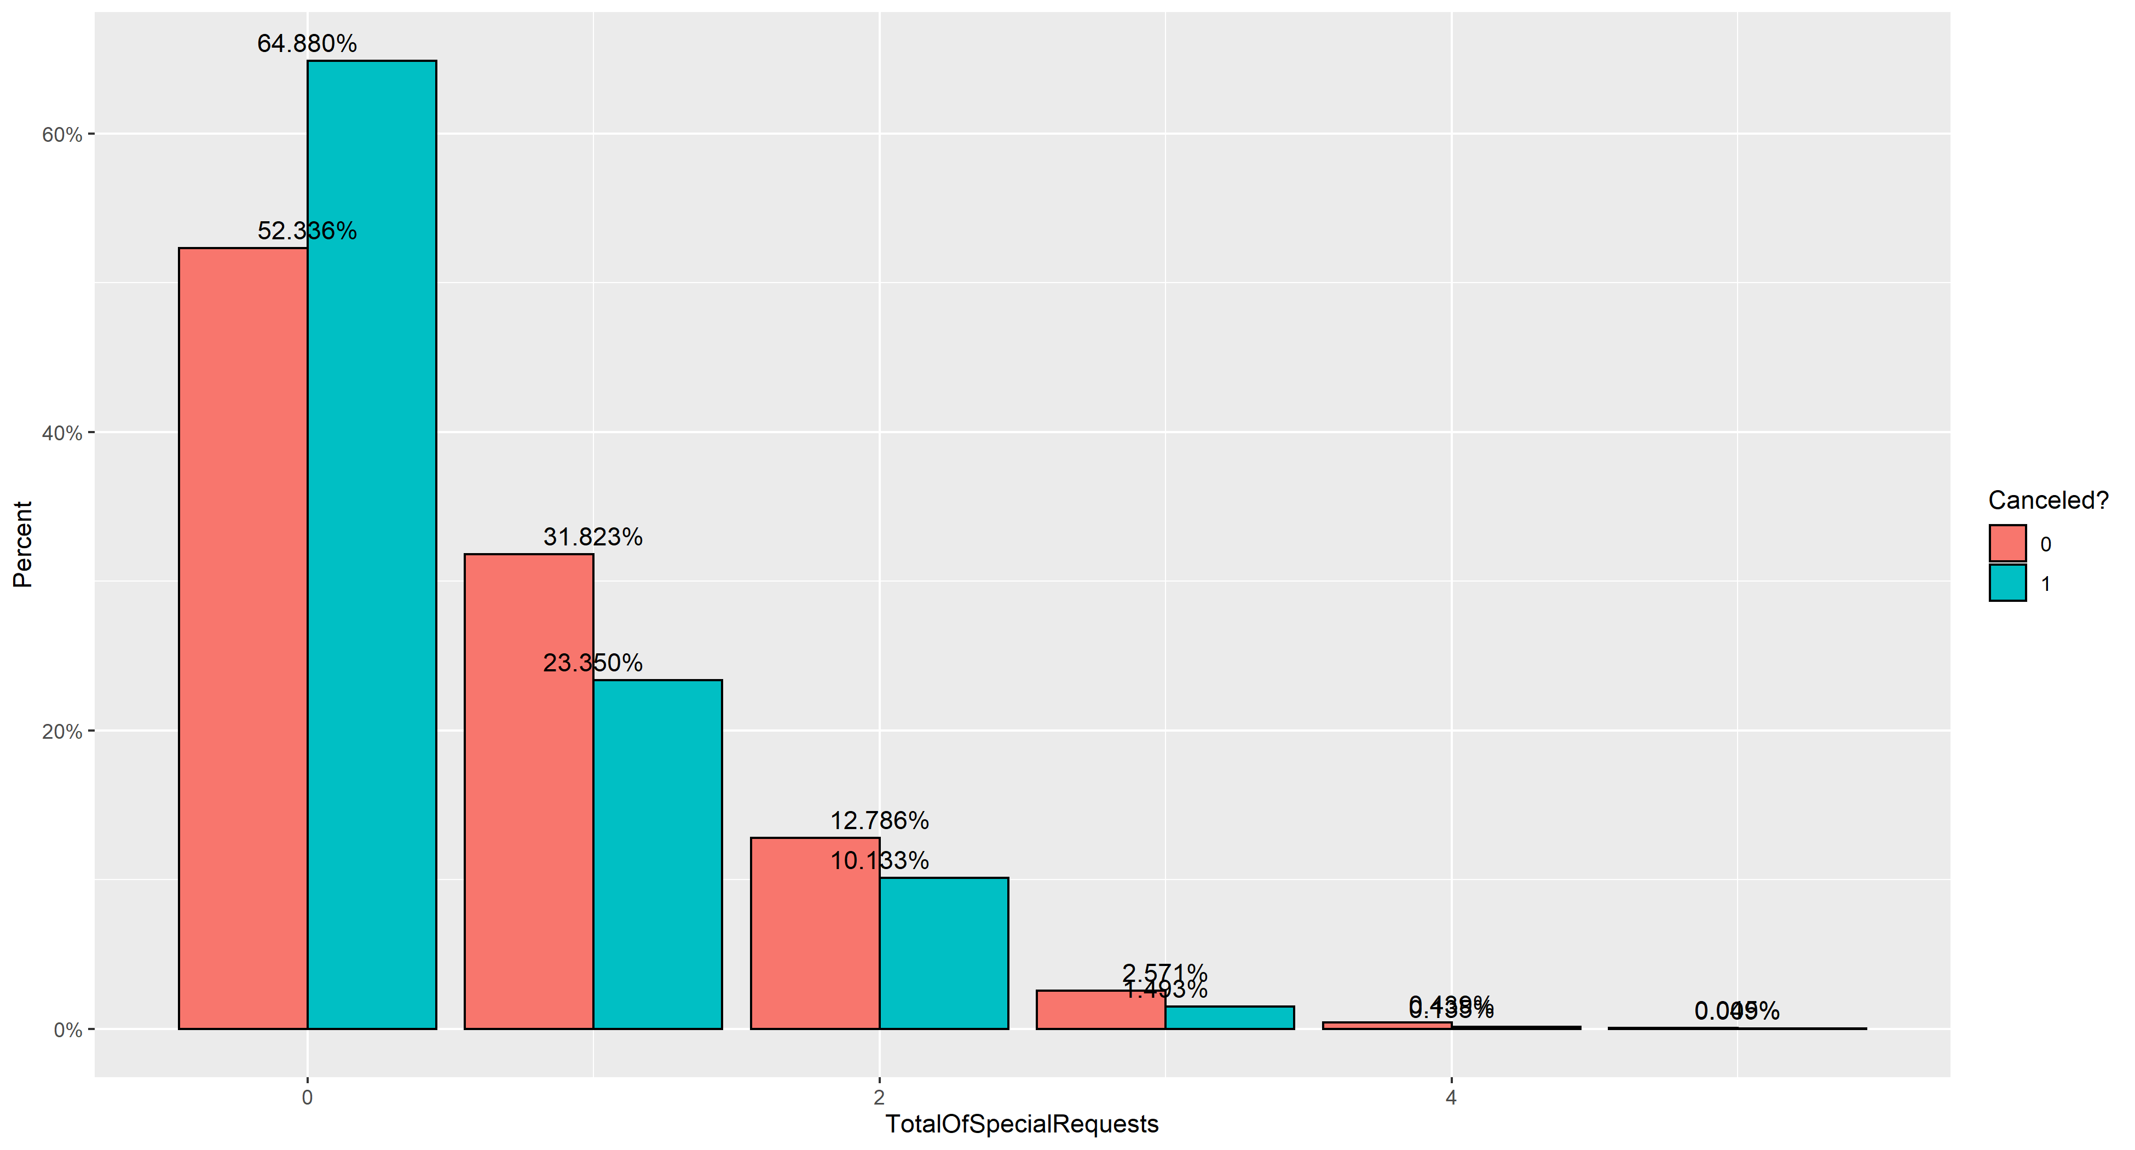
Does the Number of Special Requests Affect the Likelihood of Cancelling?
No special requests make up 65% of cancelled reservations and only 52% of non-cancelled ones

Slide 24
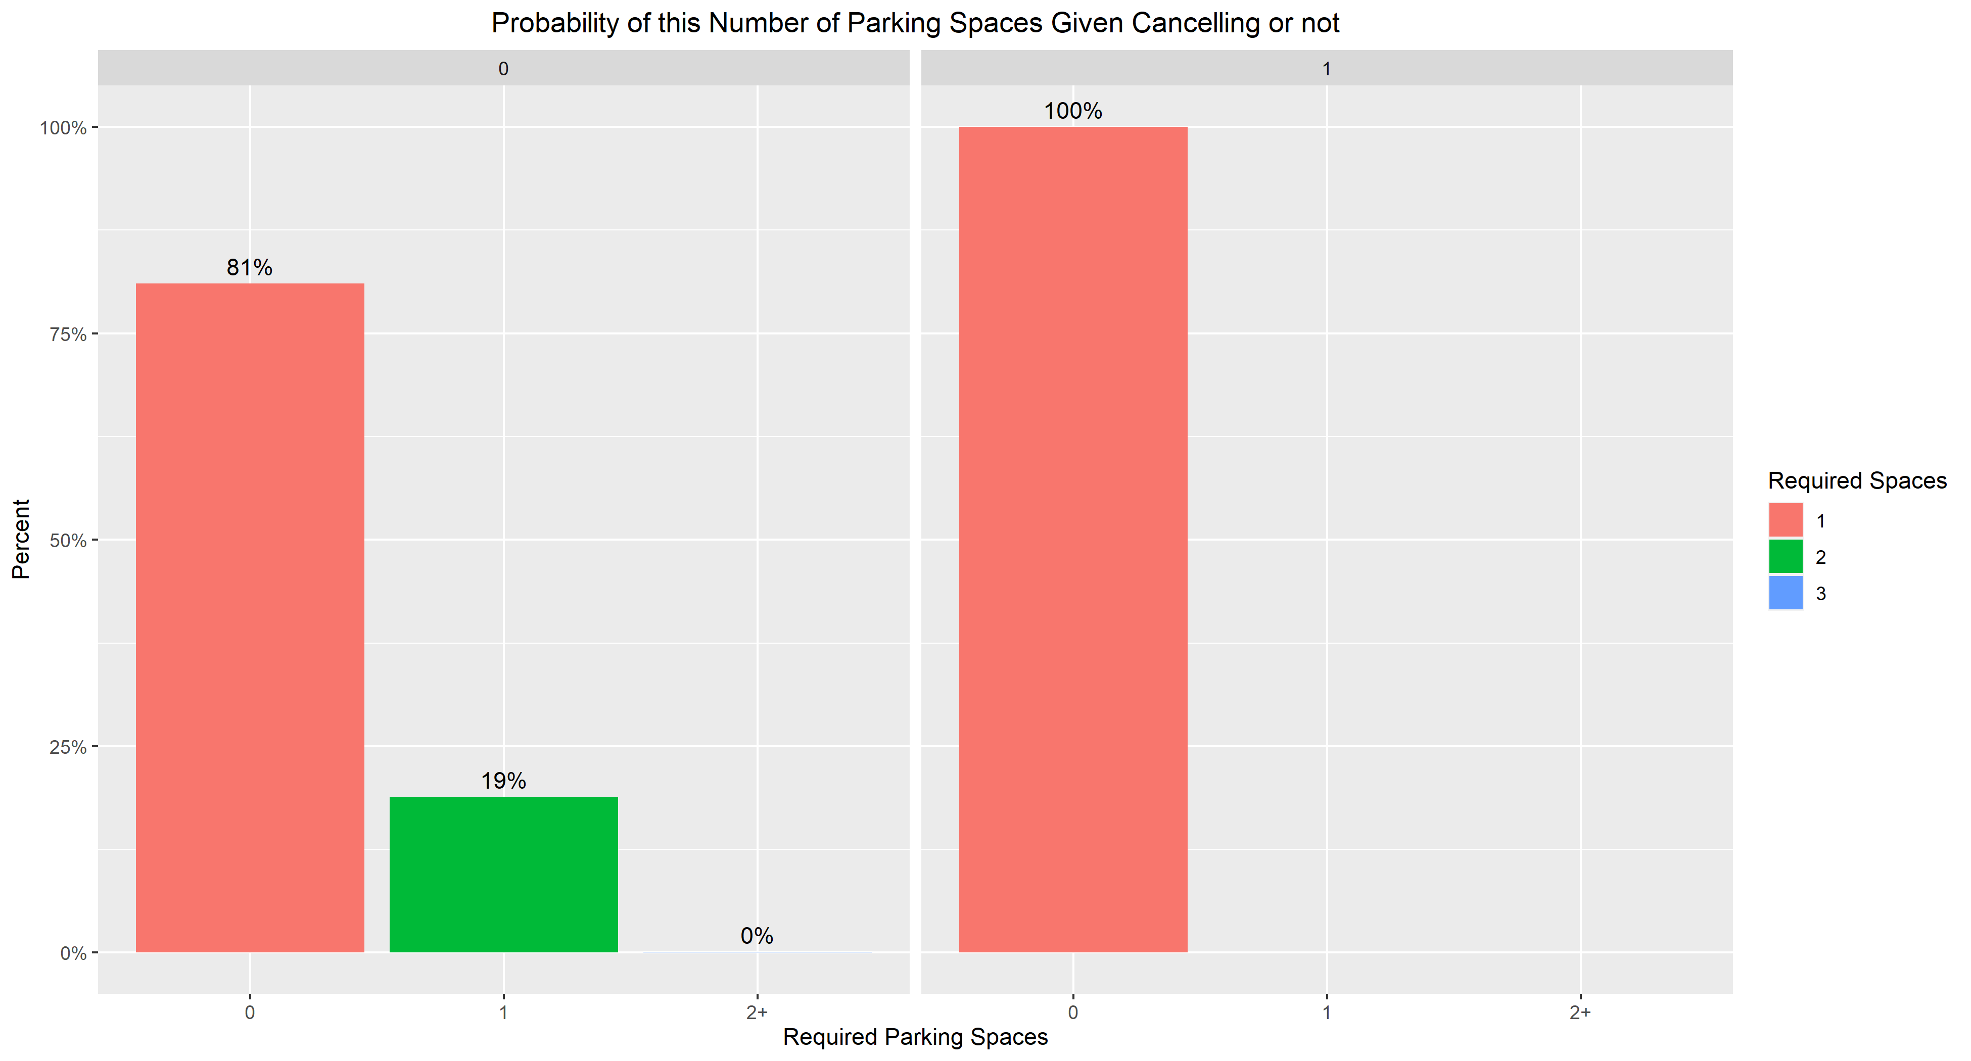
Does the Number of Parking Spaces Required by the Customer Help Predict if they Cancel?
Customers that require at least 1 parking space NEVER cancel

Slide 25

Insights from our Best Model
Country Portugal has the highest number of cancellations, as well as the highest number of bookings.
Most cancellations are made by individuals or groups, as the bookings had no children or newborns, according to the ruleset.
The Group segment is the market segment with the highest cancellations.
In general, guests who cancel their bookings are not a repeated guest

Slide 26

Insights from our Best Model
Before canceling a booking, most people do not make any changes to it. As the rule showed that the bookings had 0 changes.
The number of special requests made by customers who cancel their bookings is 0.
People have canceled the bookings due to no parking space.

Slide 27
Conclusions and Wrapping Up
There is evidence that cancellations are predictable
We strongly believe our recommendations will help fix issues that have been shown to cause cancellations
Thank you for your time and consideration!
Any questions?

